Slide 1
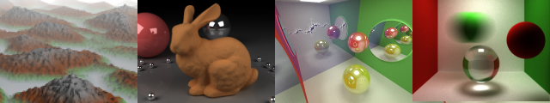
GPU Programming and Architecture: Course Overview
Patrick Cozzi
University of Pennsylvania
CIS 565 - Fall 2013

Slide 2
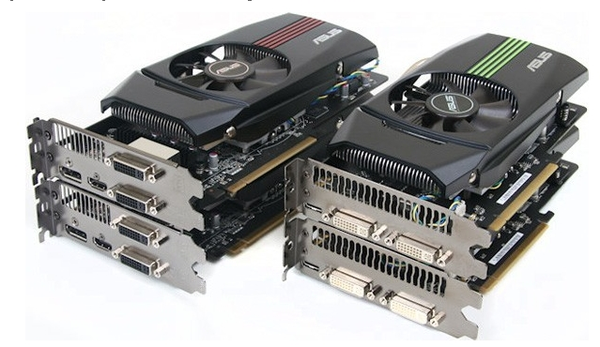
Lectures
Monday and Wednesday
6-7:30pm
Towne 307
Fall and Spring 2012 lectures were recorded
Attendance is required for guest lectures
Image from http://pinoytutorial.com/techtorial/geforce-gtx-580-vs-amd-radeon-hd-6870-review-and-comparison-conclusion/
Notes:
Lecture are optional, but everyone comes. Students even say they will stay longer because they don’t have class afterwards.
Even though the lectures are not required, come to class for the same reason that you shouldn’t work from home. Will you ever be promoted? Are you surrounding yourself by the best people you can find?

Slide 3



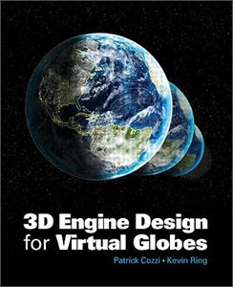






About Me
Patrick Cozzi
See http://www.seas.upenn.edu/~pcozzi/
Notes:
Cesium demo - http://cesium.agi.com/

Slide 4
About Me
Email
pjcozzi+cis565@gmail.com
Office Hours
After class
I’m here as long as you’re here

Slide 5
About Me
Not “Professor”, “Dr.”, “Mr.”, or “Sir”
Not even “instructor”
Perhaps “coach”, “catalyst”, or “enabler”
CIS 565 is a series of projects with supporting lectures.
Notes:
Perhaps we are a sports team, and each project is an event I am preparing you with. I may bring in specialists, i.e., guest lectures, in some cases just like a football might bring in a defense specialist.

Slide 6
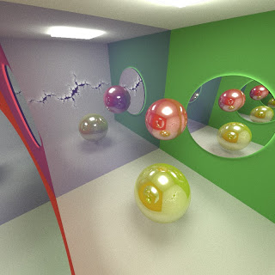
Teaching Assistant
Liam Boone: wboone@seas.upenn.edu
Office Hours
SIG Lab
TBA
See http://liamboone.blogspot.com/
Notes:
Also a developer at Sandia Lab.

Slide 7

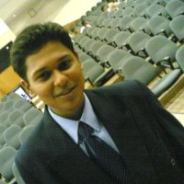
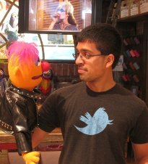






CIS 565 Hall of Fame
Jon
McCaffrey
Krishnan
Ramachandran
Varun
Sampath
Sean
Lilley
Ian
Lilley
Tiju
Thomas
Zakiuddin Shehzan Mohammed
Gundeep
Singh
Seunghoon Park
Are you next?
Notes:
Jon: System Design Engineer, NVIDIA (Android performance)
Krishnan: Character Simulations TD, Blue Sky Studios
Varun: NVIDIA (video bios)
Sean: AMD (internship working on shadows). GPU Pro 4 chapter.
Ian: AGI (internship working on materials)
Tiju: Microsoft Xbox
Shehzan: AccelerEyes (small GPU computing company; focus on performance)
Gundeep: Qualcomm (Android graphics drivers; tools for testing OpenGL ES 3.0)
Seunghoon Park: Had his CIS 565 OpenCL circular hough transform accepted to OpenCV
Students whose futures were significantly influenced, e.g., jobs, etc., by CIS 565. Not based on grades.
Many more students that either I didn’t teach or have not heard from. (I didn’t teach Jon, but he was a TA)

Slide 8
Prerequisites
Passion for computer graphics
CIS 460/560. Preferably received an A
Strong C or C++
Also useful: CIS 371 or CIS 501
I don’t check prereqs
Notes:
I don’t officially check prerequisites; the first few projects will.

Slide 9
Course Website
http://www.seas.upenn.edu/~cis565/
Schedule, reading, slides, projects, etc.

Slide 10
Google Group
https://groups.google.com/forum/#!forum/cis-565-fall-2013
Send email to cis-565-fall-2013@googlegroups.com
Be active; let’s build a course community
Notes:
Default to ask publically for the benefit of the entire class.
You’ll be involved in many communities throughout your career, let’s start now.

Slide 11

GitHub
Used for course materials, projects, and the final project
Create an account:
https://github.com/signup/free
Join our GitHub organization:
https://github.com/CIS565-Fall-2013
Who is new to source control?
Notes:
Everyone needs to learn how to use source control. Learn best practices now while in school. Also better for collaboration and backups.

Slide 12
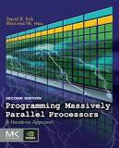
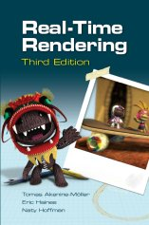
Recommended Books
Programming Massively Parallel Processors
2012, David Kirk and Wen-mei Hwu
Old draft: http://courses.engr.illinois.edu/ece498/al/Syllabus.html
Real-Time Rendering
2008, Tomas Akenine-Möller, Eric Haines, and Naty Hoffman
OpenGL Insights
2012, Patrick Cozzi and Christophe Riccio, Editors
Readings handed out in class
Notes:
See the dates on these books? This course is bleeding-edge!
If you get only one book, get Real-Time Rendering.
The best people I know read a lot.

Slide 13
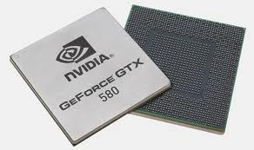
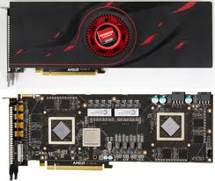
Course Topics
GPU – Graphics Processing Unit
Is it still just for graphics?
Images from http://www.ngohq.com/news/18784-nvidia-launches-geforce-gtx-580-a.html and http://gs7.blogspot.com/2011/09/amd-radeon-hd-6990-worlds-fastest.html
Notes:
The game industry is now larger than the movie industry. The demand for realistic graphics has driven innovation.

Slide 14
Course Topics
Start with GPU architecture
GPU Architecture
Not to scale
Notes:
Focus GPU memory model and threading.
Differences, and now similarities, between GPU and CPU.

Slide 15

Course Topics
CUDA programming model for GPU Compute
CUDA
GPU Architecture
Not to scale
Notes:
Knowing GPU architecture is key to programming with CUDA.
Compute examples: image processing, computer vision, financial analysis, collision detection, path planning, etc.

Slide 16
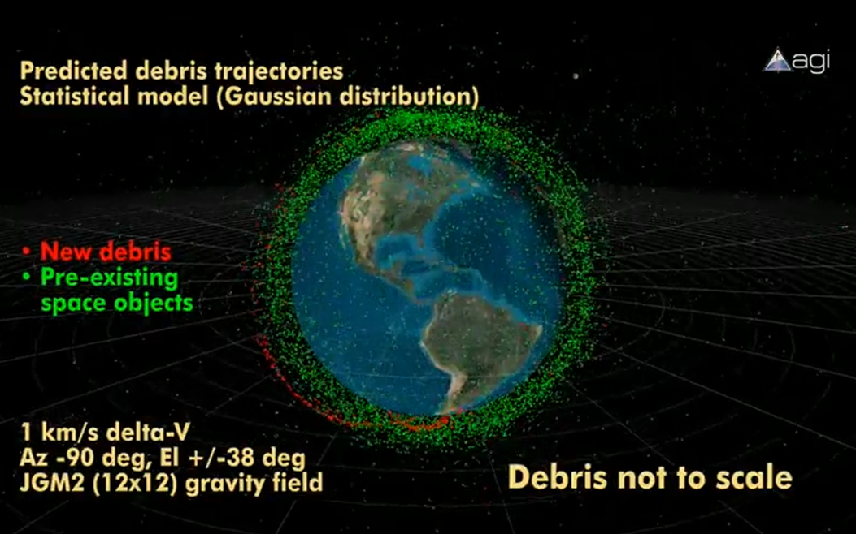
Course Topics
GPU Compute example: conjunction analysis
http://www.youtube.com/watch?v=dtT3pTh_q-8
Notes:
Hardware for a GPU solution is cheaper than a parallel CPU solution.

Slide 17
Course Topics
Parallel algorithms that form building blocks
Parallel Algorithms
CUDA
GPU Architecture
Not to scale
Notes:
Parallel reduction, scan (prefix sums), sorting, sorting, and summed area tables.

Slide 18
Course Topics
Parallel Algorithms example: Scan
Given:
Compute:
In parallel!
3
1
7
0
4
1
6
3
0
3
4
11
11
15
16
22

Slide 19
Course Topics
Historical and modern graphics pipeline
Parallel Algorithms
CUDA
Graphics Pipeline
GPU Architecture
Not to scale
Notes:
History of rasterization pipeline.
What the current generation pipeline looks like. Where is it going?

Slide 20


Course Topics
OpenGL and WebGL
Parallel Algorithms
CUDA
OpenGL / WebGL
Graphics Pipeline
GPU Architecture
Not to scale

Slide 21
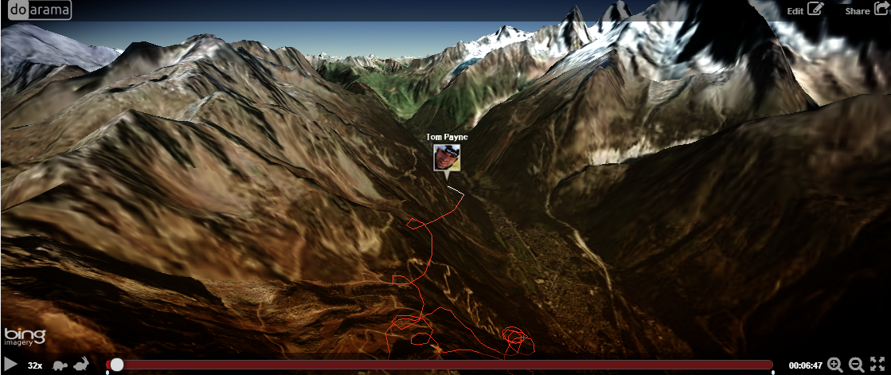
Doarama
http://www.doarama.com/

Slide 22
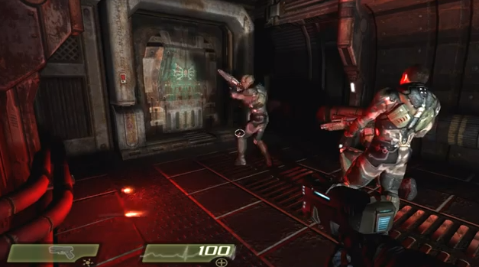
Turbulenz
http://www.youtube.com/watch?v=AJg_BmY9-8o
Notes:
http://www.shader.org/webglcamp/slides/s2_4.pdf
Quake 4 assets
1694 assets – compression and caching
353 lights, 346 particle systems – culling with portals and bounding-box trees
55 shading techniques, 451 materials – sort by technique and material
“huge number of dynamic lights and shadows, high quality animated skinned characters, particle systems with multiple stages, 2D GUIs and animations mapped onto 3D objects, and a great variety of materials and shading effects.”
“portal-based scene manager.”

Slide 23
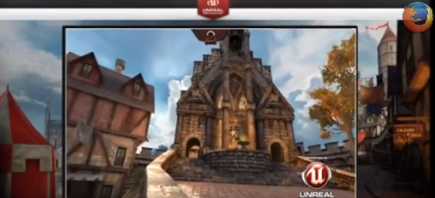
Unreal 3
https://blog.mozilla.org/blog/2013/03/27/mozilla-is-unlocking-the-power-of-the-web-as-a-platform-for-gaming/

Slide 24
Course Topics
Real-Time Rendering
Real-Time Rendering
Parallel Algorithms
CUDA
OpenGL / WebGL
Graphics Pipeline
GPU Architecture
Not to scale

Slide 25
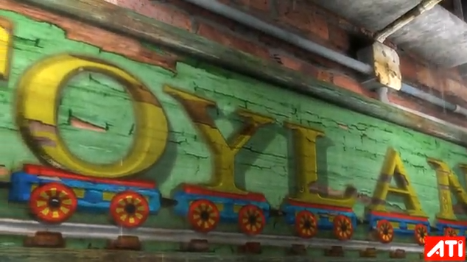
AMD Toyshop Demo
http://www.youtube.com/watch?v=LtxvpS5AYHQ
Notes:
http://developer.amd.com/media/gpu_assets/ToyShop-Eurographics_AnimationFestival.pdf
From 2006 (pre unified shader architecture, wow) – Radeon X1800 at 26-29 fps
Parallax Occlusion Mapping – self-shadows, perspective-correct: bricks, wood letters, sidewalks
28 MB vertex/index. 156 MB for (compressed) textures. 54 MB for framebuffers. Total 240 MB.
500 different shaders.
250 draw calls for 200-500K polygons and 0-22K particles
Post-processing effects for glow, blurry reflections, and rain
Water simulation on GPU using Euler integration (only SM 2.0!)

Slide 26
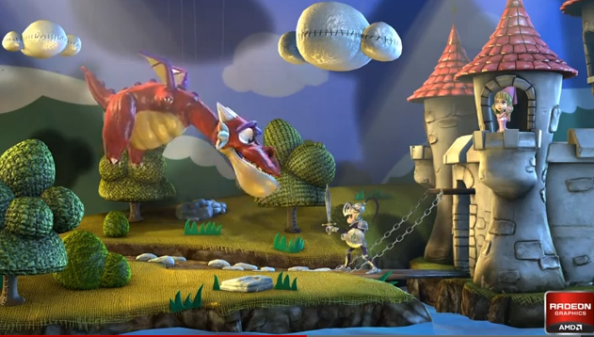
AMD Leo Demo
http://www.youtube.com/watch?v=zYweEn6DFcU
Notes:
http://developer.amd.com/Resources/documentation/samples/demos/pages/AMDRadeonHD7900SeriesGraphicsReal-TimeDemos.aspx
Also see - http://www.youtube.com/watch?v=s2y7e3Zm1xc
Complex materials AND many lights AND many light models.
Use compute to cull lights per tile. Forward shade per tile only with affecting lights.
One bounce global illumination effects by spawning virtual point light sources where light strikes a surface.
Multiple BRDF equations, realistic use of index of refraction, absorption based on wavelength for metals, etc.

Slide 27

GPU Compute + Rendering
http://www.nvidia.com/object/GTX_400_games_demos.html
Notes:
Smoke - fluid simulation
Compute particles - bridge 1,000,000 particles
Terrain - Tessellation shader

Slide 28
Course Topics
Mobile
Mobile
Real-Time Rendering
Parallel Algorithms
CUDA
OpenGL / WebGL
Graphics Pipeline
GPU Architecture
Not to scale
Notes:
And hopefully console architectures too…

Slide 29
Course Topics
Performance!
Mobile
Real-Time Rendering
Parallel Algorithms
CUDA
OpenGL / WebGL
Graphics Pipeline
GPU Architecture
To scale!
Notes:
GPUs are about doing data-parallel problems quickly!
Walk clock performance. Not theoretical.

Slide 30
Course Topics
Topics are as time permits
We constantly adjust the schedule during the semester
Notes:
For example, we’ll replace a lecture with a guest lecture or a hackathon.

Slide 31
Guest Lectures
Shehzan Mohammed
Tim Kaldewey
Eric Haines
Eric Lengyel
Kevin Ring
…
http://cis565-fall-2013.github.io/schedule.html

Slide 32
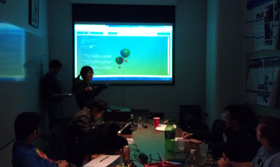
Hackathons
Cancel class, and code for prizes instead
Notes:
Fun. Practice intensity. Get exposure. Team building.
http://blog.virtualglobebook.com/2012/12/hackathons-in-classroom.html

Slide 33
Grading
Projects 60%
Final Project 40%
Final 0%
Notes:
Quest for knowledge vs. question for grades.
Some outstanding students don’t have great grades. Most students with great grades do well outside of school.
This is a pragmatic course about creating outstanding GPU/graphics developers. I don’t care if you can pass a test. No midterm. Mostly no written homework

Slide 34
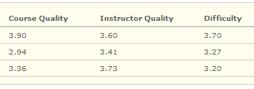
Projects
Intense.
Significantly more work than other courses.
Notes:
Rebrand homework as projects. Change culture. No one wants to do homework.
Numbers lie, but when the course gets harder, students like it more.

Slide 35
Projects
Each project has
Coding
Pick x of n, e.g., 3 of 5, plus open-ended parts
Written performance analysis
Write-up with screenshots and a video/demo
Random in-class demos. Show, don’t tell.
Notes:
Replacing student presentations with in-class demos: live or video, not sure yet.
Practice writing and positioning your work.
Everyone needs to learn how to talk in front of a group and sell themselves. The demo will be the class following the due date.

Slide 36
Projects
Due anytime on the due date
Submitted using GitHub
Late Policy
1 second to 1 week late: 50% deduction

Slide 37
Projects
Grade yourself. Seriously
We reserve 30% of the grade as a sanity check
Notes:
Build self-awareness. We focus on feedback, not grades.

Slide 38
Projects
Can be done as open source
Build your code portfolio
Want to use private repos? Get a free edu account
https://github.com/edu

Slide 39

On Interviews…
“Send me your code and then we’ll talk”
- Christophe Riccio

Slide 40
Intensity
Effort
Effort
Time
Time
Student
Pro boxer
Due date
Fight night
Notes:
What can we learn from boxing?
Not to scale; ignore integrating to see the area of the region under the curve.
Actually, we can learn a lot more from boxing: continuous feedback, intensity, etc.
Avoid burning out or making mistakes at the very end. Avoid unforeseen problems. “Early and often.”
I suggest to move the peek even sooner. Hit it hard right away. Line up your effort with office hours, so you can get help early and late.

Slide 41
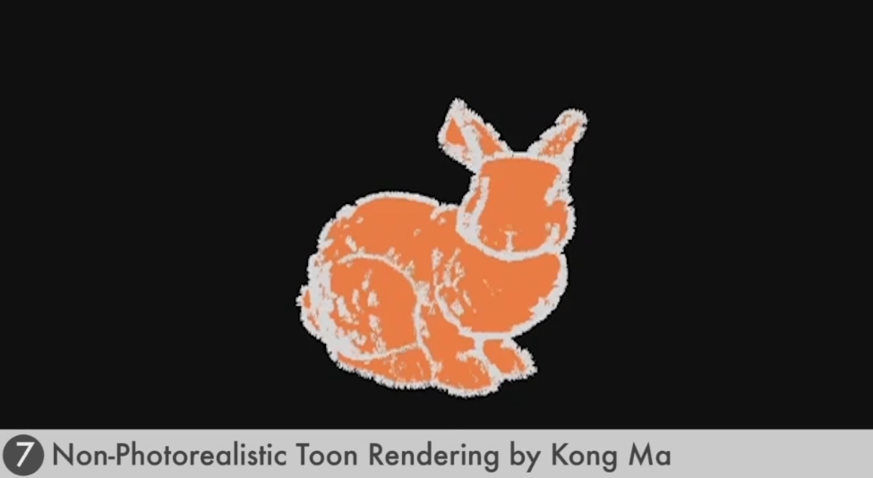
Last Semester’s Projects
http://cis565-fall-2012.github.io/index.html

Slide 42
Academic Integrity
http://www.upenn.edu/academicintegrity/
An academic integrity violation will result in the student receiving an F in this course
Get approval for all code you didn’t write yourself with the TA in advance
Notes:
Example: for a depth-of-field project, it is OK to use a third-party library to load models, but it is not OK to use a depth-of-field fragment shader found in google.
Copying from another student is not OK. If two students have the same exact code, and it is wrong…
Be ready to explain any part of your code.
Violating academic integrity is bad for you, your peers, and your university. It literally steals time away from making the course better for everyone.

Slide 43
GPU Requirements
Most projects require an NVIDIA GeForce 8 series or higher
Update your drivers:
http://www.nvidia.com/Download/index.aspx
What GPU do I have?
What OpenGL/OpenCL/CUDA version:
http://www.ozone3d.net/gpu_caps_viewer/

Slide 44
GPU Requirements
Lab Resources
Moore 100b - NVIDIA GeForce 9800s
SIG Lab - Most systems have at least NVIDIA GeForce 8800s. Two systems have a GeForce 480, three have Fermi Quadros, one has a Fermi Tesla, and one has an AMD card

Slide 45
CPU and GPU Trends
FLOPS – FLoating-point OPerations per Second
GFLOPS - One billion (10⁹) FLOPS
TFLOPS – 1,000 GFLOPS
Notes:
FLOPS are not a perfect measurement because of memory access, instruction mix, branches, etc. Peak FLOPS are idealistic, but not often reached in practice.

Slide 46
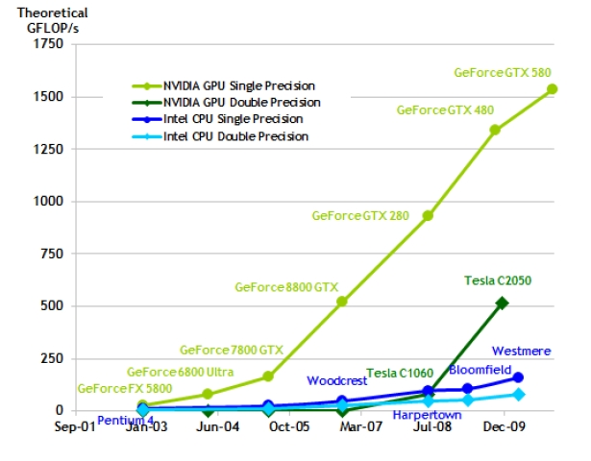
CPU and GPU Trends
Chart from: http://proteneer.com/blog/?p=263
Notes:
Moore’s Law – the number of transistors on a chip will double about every two year
High FLOP per watt
High FLOP per dollar
High FLOP per mm

Slide 47
CPU and GPU Trends
Compute
Intel Core i7 – 4 cores – 100 GFLOP
NVIDIA GTX280 – 240 cores – 1 TFLOP
Memory Bandwidth
System Memory – 60 GB/s
NVIDIA GT200 – 150 GB/s
Install Base
Over 375 million CUDA-capable GPUs

Slide 48
Class Exercise
Graphics Pipeline

Slide 49
Reminders
Google Group
Signup: https://groups.google.com/forum/#!forum/cis-565-fall-2013
GitHub
Create an account: https://github.com/signup/free
Change it to an edu account: https://github.com/edu
Join our organization: https://github.com/CIS565-Fall-2013

